Slide 1

A Food Waste Solution
Team Name: Equipo
(Oscar Gordillo and Max Wootten)

Slide 2
43,000,000,000
Pounds of food go to waste in American grocery stores annually.
(via Quest Resource Management Group)
Notes:
43 billion

Slide 3
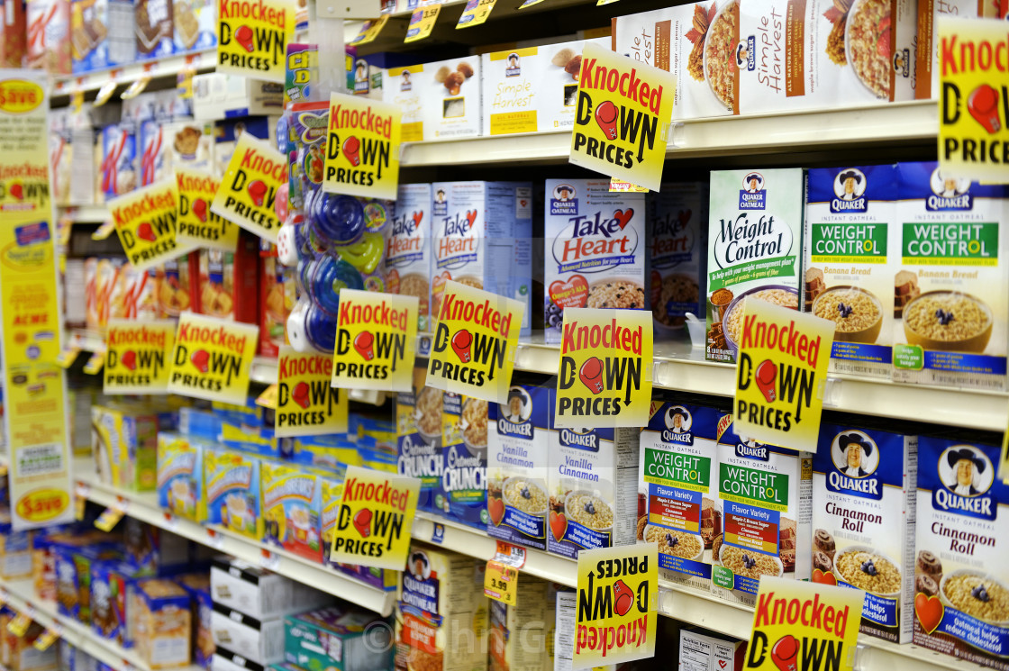
Notes:
One part of the grocery store food waste problem is food that expires on the shelves. Now, the store wants to sell more food, and many buyers want deals. People check the sale/reject/expiring soon shelf hoping to find a hidden gem, but most the time it is pure luck. Instead, what if the stores could tell it’s consumers when products are nearing their expiration date and thus going on sale. It is a win win for all.

Slide 4
Our Solution:
LastCall
A vendor to consumer web application
Vendors post when an item is about to expire and is discounted

Slide 5
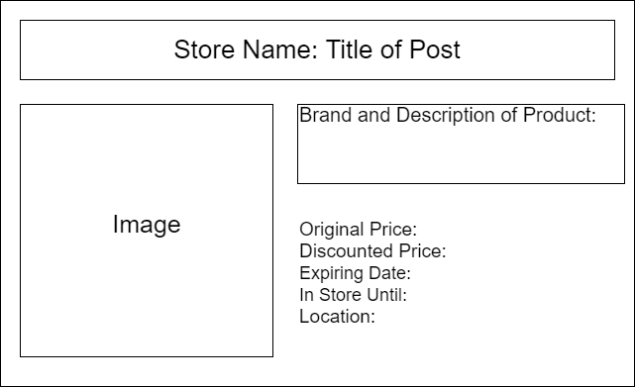
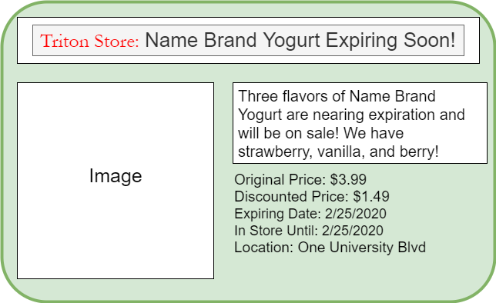
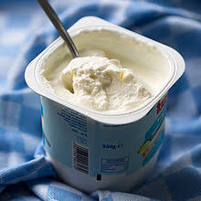

Slide 6
Goals:
Tech
Set up authentication through Firebase
Fix javascript
App
Add functionality for food banks
Add info to decipher expiration labels
World
Eliminate food waste around the globe

